Slide 1
Buyer’s
Journey
Findings
Qianyu Zhao | Justin Sherman
Alyse Borelli | Joe Zhao | Carter Lipnick

Slide 2
Agenda
Underlying Data & Metrics
Acquisition Channel & Device Performance
Category Performance
Retention
Recommendation
Next Step

Slide 3
North
Star
Metric
(NSM)
Our Business model is based on how much customers purchase (Wallet Economy).
# of purchased transactions

Slide 4
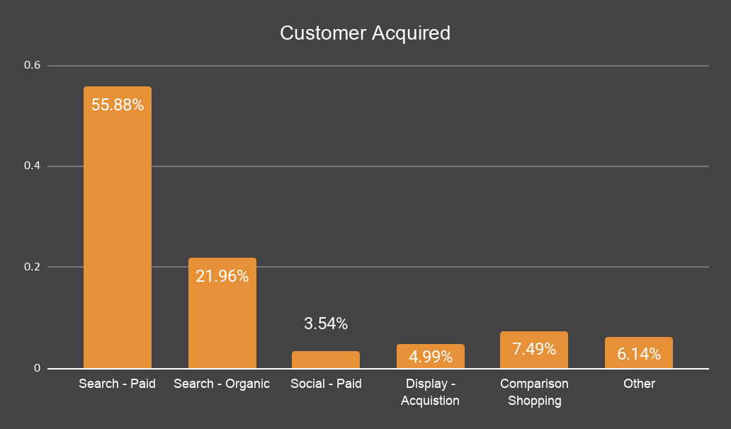
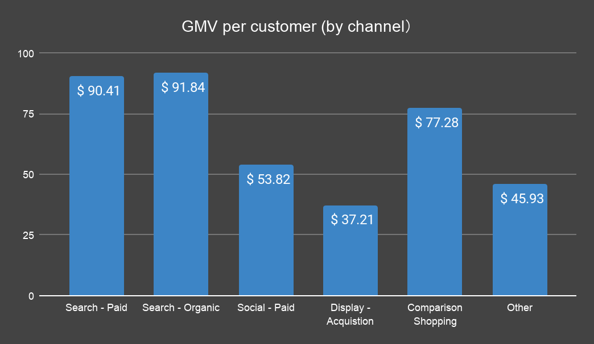
Performance by Acquisition Channel
56% acquired through ‘Search-Paid’
22% acquired through ‘Search-Organic’
7.5% acquired through ‘Display-Acquisition’
However, ‘Search-Organic’ channel generates the highest GMV per customer ($91).
Comment: Although we don’t know how much Avocci invested in the search channel, or whether the ROI of this investment was high. With our limited statistic, ‘Search -Organic’ channel seems to have great potential to bring more profits
Recommendation: Avocci should check current search ranking and optimise website page in the long-term

Slide 5
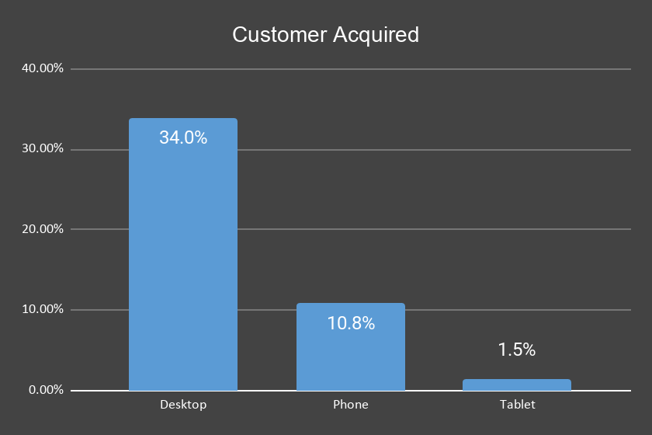
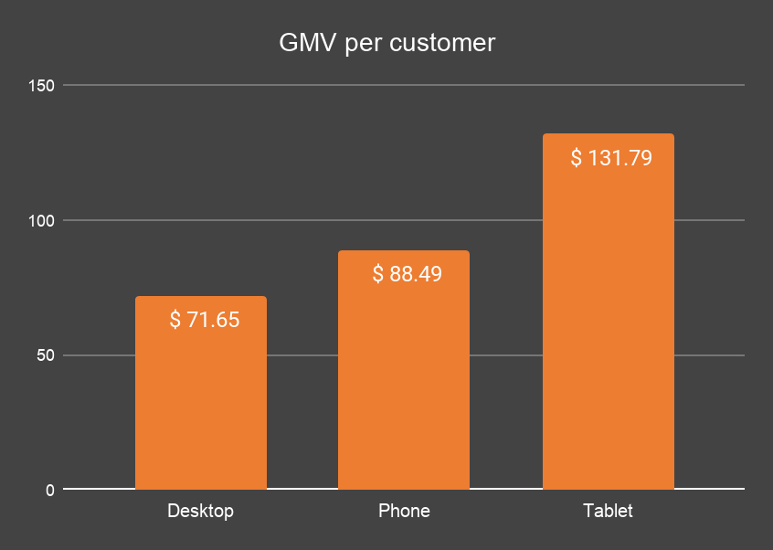
Performance by Acquisition Device
The ranking of acquisition device is Desktop(34%)>Phone(10.8%)>Tablet(1.5%). However, the ranking of GMV per customer of acquisition device is the opposite, Tablet > Phone > Desktop.
Comments: Although the sample size on tablet is not large enough to reach the conclusion that it brings in the highest purchase conversion, but there is a tendency that users with tablets are willing to spend more money.
Recommendation: Avocci should conduct another test to validate our finding & examine possible issues that lead to low tablet users (user experience with tablet, etc).

Slide 6
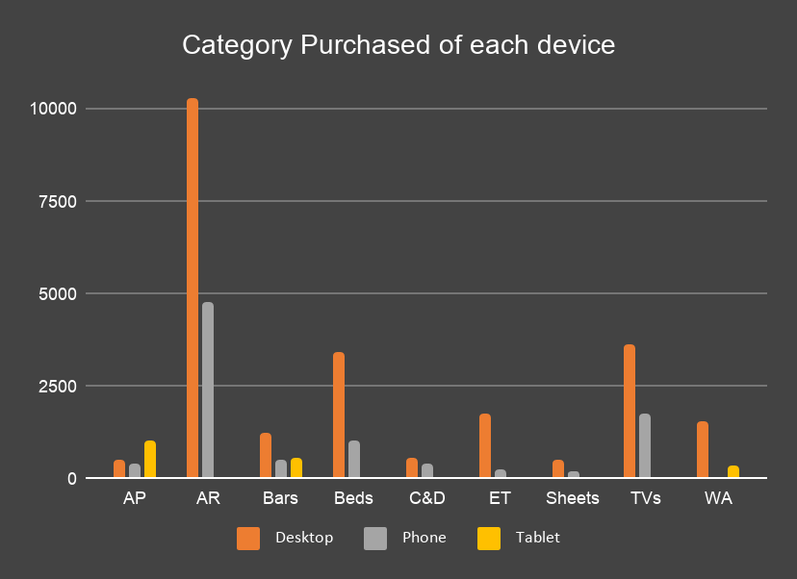
Recommendation & Strategy
Customers acquired through device ‘Desktop’ and ‘Phone’ are willing to spend more on categories AR, Beds and TVs.
Customers acquired through device Tablet are willing to spend more on categories AP, Bars and WA.
Recommendation: Target customer groups based on their device and push promotional content based on their top-buying category.
For example, send advertisements of AP, Bars and WA to customers acquired through Tablet.

Slide 7
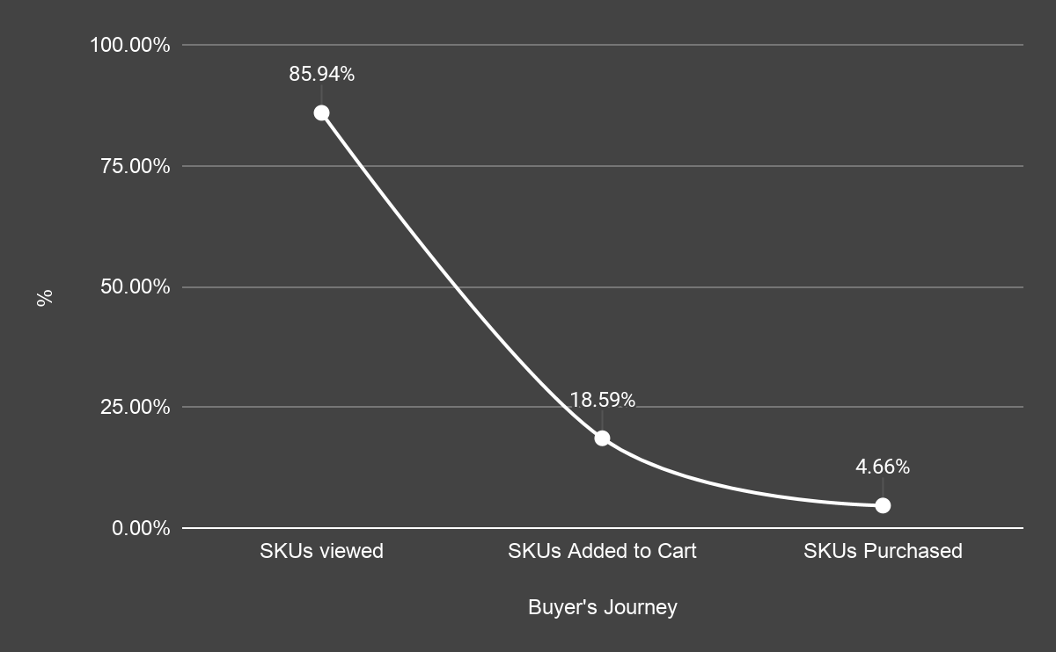
Buyer’s
Journey
Conversion
Drastic drop in View Conversion and Cart Conversion.
Notes:
***This is the conversion based on total number
We can see that conversion rate in general is low across the buying process

Slide 8
Buyer’s
Journey
Key
Metrics
Results
View Conversion
85.94% of the customers clicked to view the products after browsing different category.
Cart Conversion
21.64% of the customers added item to their cart after browsing
Purchase Conversion
25.05% of the customers who added an item completed the purchase
(aka)Cart abandonment rate
74.95% left the site after adding products into the cart
Notes:
These are conversion metric based on the PREVIOUS stage, NOT BASED ON TOTAL NUMBER!

Slide 9
Rec.
SKU Viewed, but nothing added to the cart: 21.64%
Possible Issues & Recommendations:
Customers did not like something about the product (function,aesthetics, price) A/B testing by placing high-demanded product (like AR & BEDS) to the top, adjust web page layout to emphasize Call to Action Button.
Cart abandonment rate:74.95%
Possible Issues & Recommendations:
Expensive, creating hesitancy and abandonment A/B test to have installment payment options.
Lack of payment options Offer the most popular payment methods for our target audience.
Lack of trust for the company & product. Provides generous refund policy & 24/7 customer support.
Notes:
Conversion rate By category

Slide 10
Rec.
art Abandonment Rate:74.95%
Possible Issues & Recommendations:
Expensive, creating hesitancy and abandonment A/B test to have installment payment options.
Lack of payment options Offer the most popular payment methods for our target audience.
Lack of trust for the company & product. Provides generous refund policy & 24/7 customer support.C
(Continued)
High shipping costs Offer free-shipping or promo codes.
Complex Check-out Process Review the checkout process and reduce the steps to as easy and painless as possible.
Lack of trust to provide personal information online. Clearly states that “personal information will be protected” on the check-out page. Provides optional account-creating process.
Other Recommendations: Increase Push Messaging, Promotional Email, Recommendation Personalisation, Web Notification and SMS/MMS.
Notes:
Conversion rate By category

Slide 11
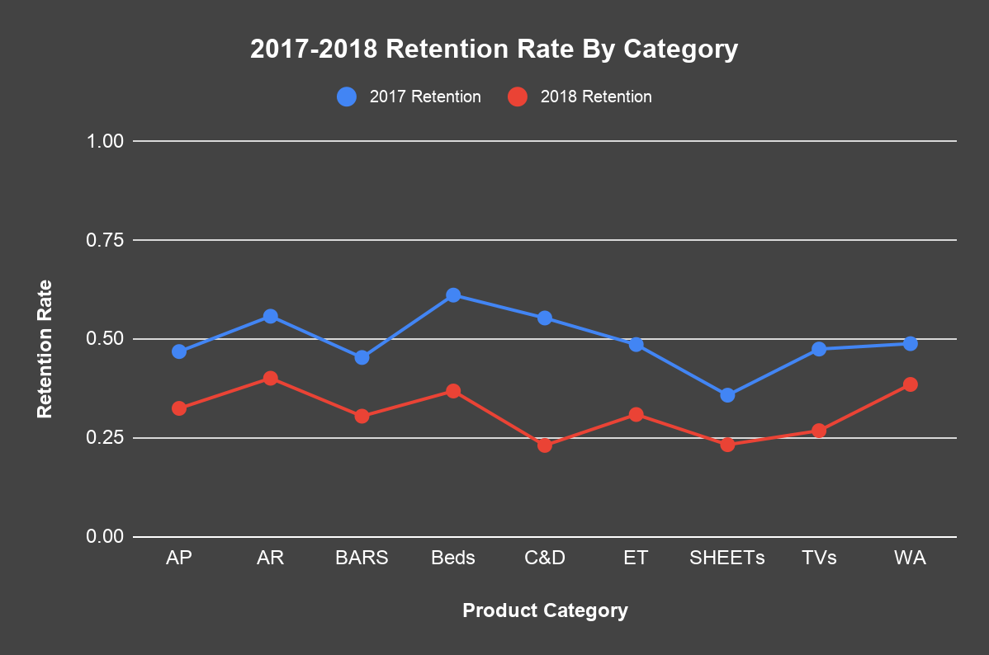
Retention Rate By
Category

Slide 12
Retention Rate By
Category
Findings
2017
Highest retention rate:
1. Beds 61.1%
2. AR 55.7%
3. C&D 55.2%
Lowest retention rate:
1.Sheets 35.7%
2.BARS 45.2%
3.AP 46.7%
2018
1. AR 40%
2. WA 38.4%
3. BEDS 36.8%
1.C&D 23%
2.SHEETs 23.2%
3.TV 26.8%
Drastic Change in Retention Rate seen in Beds (24% drop) & C&D (32.2% drop).
Comment: For Beds, it's natural that customers aren't returning to buy a new one only after one year; For C&D, unclear why the second-year conversion rate is low.
Recommendation:
Avocci should find out whether it’s a quality issue that people aren’t back to buy C&D, or the product life cycle determined this phenomenon.

Slide 13
Repeat Purchase Conversion
Repeat Buyers: 22.62% of the customers who have purchased goods from our site return back to site to purchase for the 2nd time
Purchase Number | Actual # of ID | % of returning purchase
1 | 221
2 | 50 | 22.62%
3 | 21 | 9.50%
4 | 14 | 6.33%
5 | 2 | 0.90%
8 | 2 | 0.90%
Low Repeat Purchase Conversion: 16.03%
Possible Issues & Recommendations:
Error Personalized Recommendation (Recommend similar beds after one purchase) Optimize personalized recommendation (Bed -> Sheets) Customized marketing message (timed) to tailor to buyer’s journey.
Customers aren’t satisfied with the product quality Send post-purchase survey after each purchase, and have customer service follow up individually if the rating is below a certain score.

Slide 14
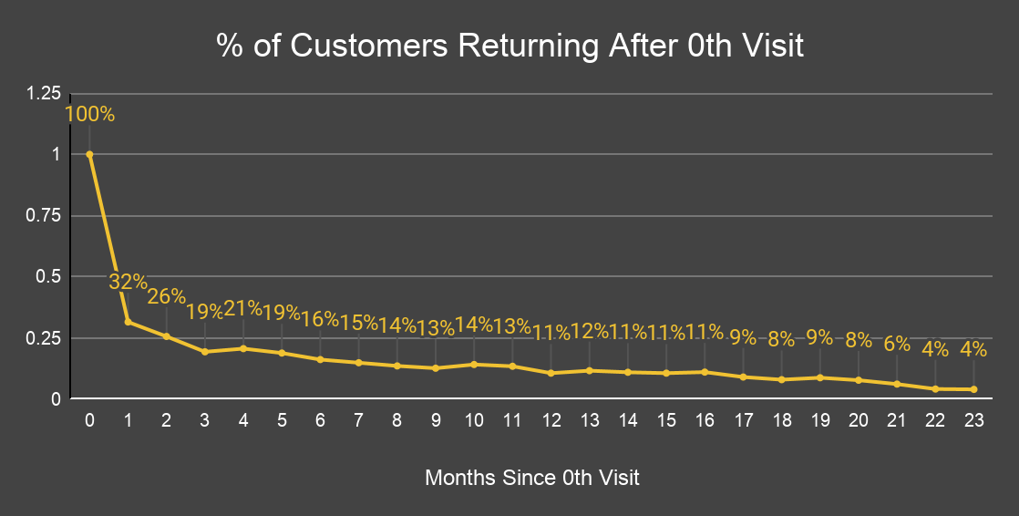
Lifetime Activity of Users
Very large drop off in retention from 0th to 1st month of viewing products on site
Only 32% of customers return the month after (68%drop)
26% of customers view products on site two months after initial viewing
Slight increases in retention in 10th, 13th, 16th, 19th month
Notes:
Get people addicted/attached early! Don’t wait until it’s too late
Takeaways: 1) Need to focus efforts on retaining people after 0th month encounter through rewards, perks, incentives for monthly shopping
2) Potential recurring product/site use every 3 months, dive into the various categories to determine frequency of purchase; use remarketing in these months to target specific customer IDs

Slide 15
Lifetime Activity of Users
Very large drop off in retention from 0th to 1st month of viewing products on site
Only 32% of customers return the month after (68%drop)
26% of customers view products on site two months after initial viewing
Slight increases in retention in 10th, 13th, 16th, 19th month
Comment & Recommendations:
1) Focus efforts on retention after 0th month encounter using rewards & incentives for monthly activity
2) Recurring site use every 3 months; dive into specific categories to determine frequency of purchase; use remarketing in these months to hyper-target specific customer IDs
Notes:
Get people addicted/attached early! Don’t wait until it’s too late
Takeaways: 1) Need to focus efforts on retaining people after 0th month encounter through rewards, perks, incentives for monthly shopping
2) Potential recurring product/site use every 3 months, dive into the various categories to determine frequency of purchase; use remarketing in these months to target specific customer IDs

Slide 16
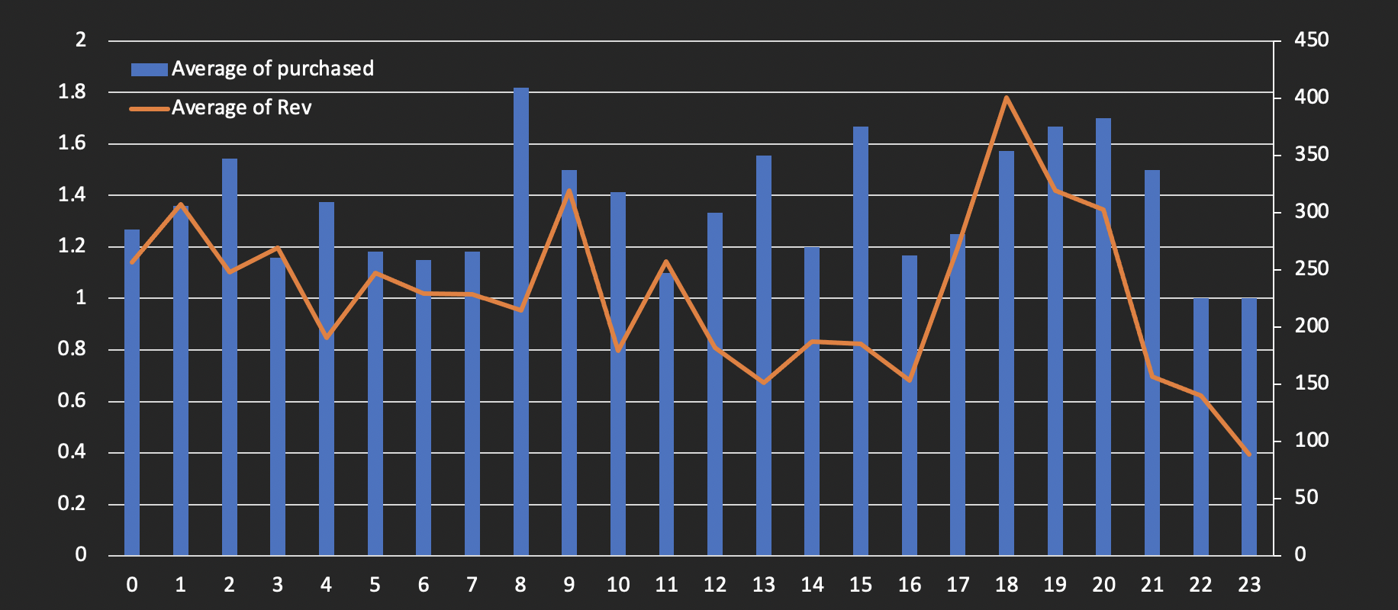
Repeat Conver-sion
Average Purchase Quantity (NWM) fairly constant over the buyer journey. Notable peaks at 8 months after initial visit, 15th month, and 18-20th month
Average revenue generated goes slightly down over time and shoots up from 16th to 18th month
Notes:
REC. customer outreach (email) around 16th month to help that number spike even higher

Slide 17
Next
Steps
Find out how much we spend on each marketing channel. Input this information into our data to determine CAC.
Determine which of our recommendations the sales and marketing team are most interested in pursuing at this time.
Set up a meeting with marketing, data analytics, and web designers to determine implementation strategy.
Set up tracking and begin working on implementation of new strategies.

Slide 18
Other
Metrics
Average Shopping Cart Size：$222.09
(*)Customers who purchased at our site has an average shopping cart size of $222

Slide 19
Other
Metrics
Average Shopping Cart Size：$222.09
(*)Customers who purchased at our site has an average shopping cart size of $222

Slide 20
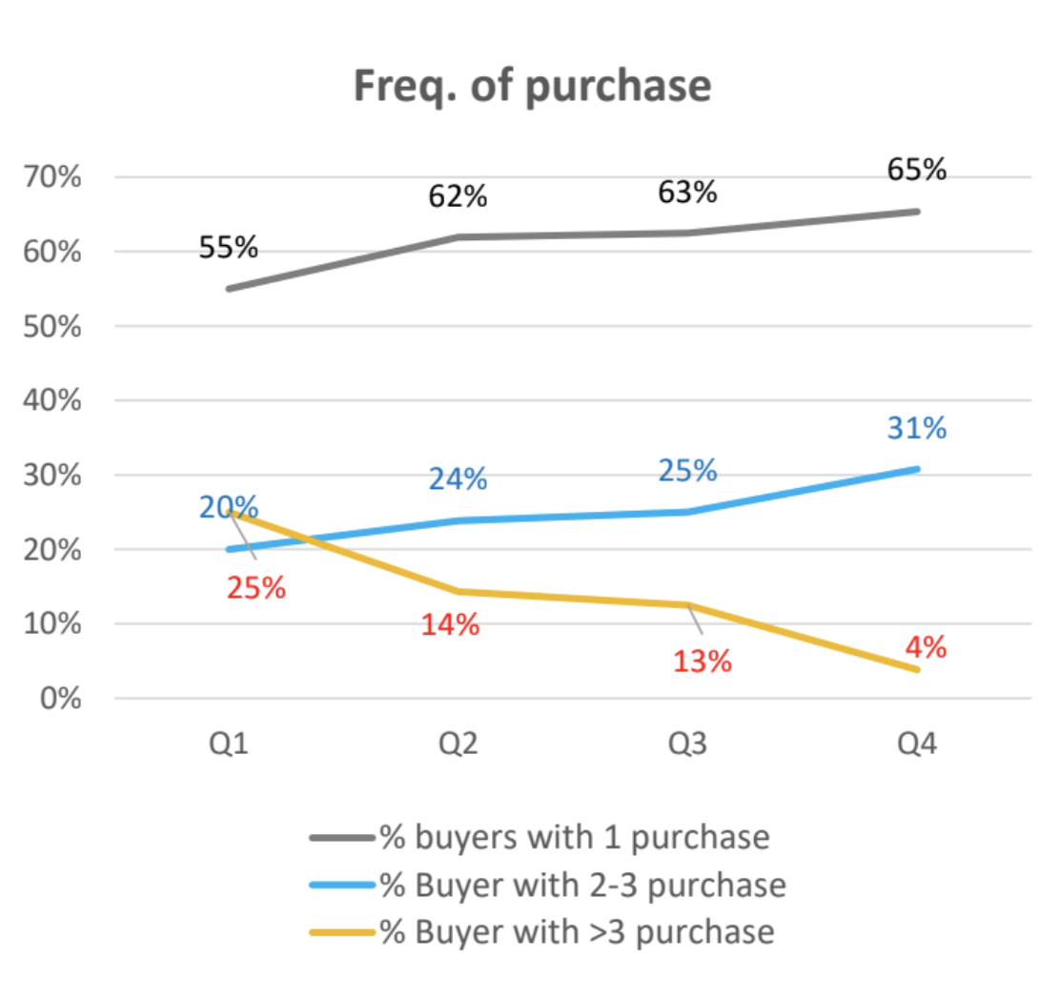
Limitations
& Areas To
Explore?
Correlation between category and returning purchase?
Relationship between channel & Returning customers?
Relationship between channel & shopping cart size?
(?) CLV formula: we don’t know the average customer lifetime right?
How to segment the year?
Grow Customer base by expanding social media presence? Loyalty Program?
Potential power users: people like “21” visited the site >8 times browsing through various categories but never purchased. (latent demand?) Also how to quickly find them in excel? → interest-free monthly installment pay,
Notes:
Segment by channel? Reach more people?
Bucket people with high site visit but low purchase

Slide 21
Rec.
Low Cart Conversion: 21.64%
Possible Issues:
Customers Forgot to “add-to-cart”
A/B testing by placing high-demanded product (like AR & BEDS) to the top, adjust web page layout to emphasize Call to Action Button.
Low Repeat Purchase Conversion: 16.03%
Possible Issues:
Error Personalized Recommendation (Recommend similar beds after one purchase) 、
Optimize personalized recommendation (Bed -> Sheets) Customized marketing message (timed) to tailor to buyer’s journey
Customers aren’t satisfied with the product quality
Send post-purchase survey after each purchase, and have customer service follow up individually if the rating is below a certain score.
Notes:
Conversion rate By category

Slide 22
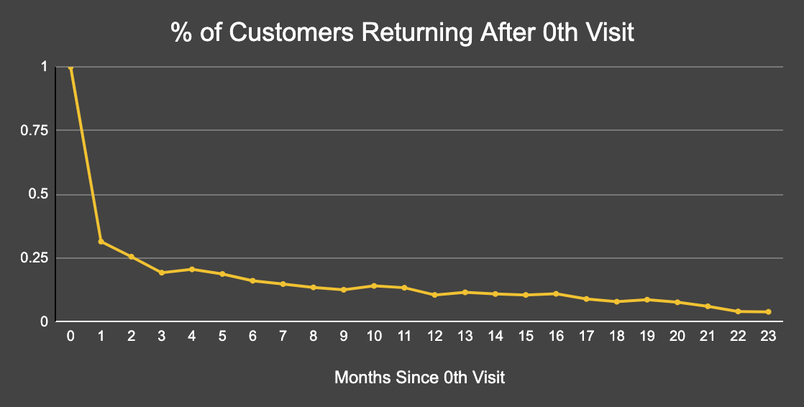
Lifetime Activity of Users
Notes:
Get people addicted/attached early! Don’t wait until it’s too late
Takeaways: 1) Need to focus efforts on retaining people after 0th month encounter through rewards, perks, incentives for monthly shopping
2) Potential recurring product/site use every 3 months, dive into the various categories to determine frequency of purchase; use remarketing in these months to target specific customer IDs

Slide 23
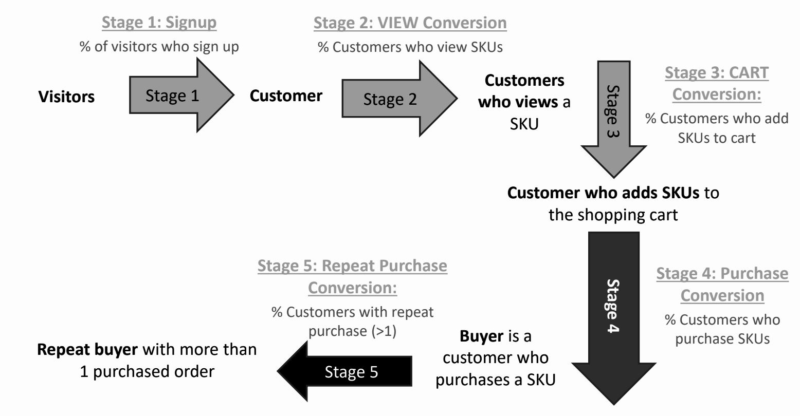
Buyer’s
Journey
& Key
Metrics
View Conversion
Notes:
I think we can skip this slide - Carter
Ok! - Clem

Slide 24
Buyer’s
Journey
Calculation 1
 | year | month | Category | skus viewed | skus added to cart | skus purchased | Revenue generated ($)
Conversion # (count) |  |  | 10003 | 8597 | 1860 | 466 | 466
Conversion % |  |  |  | 85.94% | 21.64% | 25.05%
Churn Rate % |  |  |  | 14.06% | 78.36% | 74.95%
Total # | 3 | 24 | 9 | 136436 | 8262 | 566 | $103,492.00

Slide 25
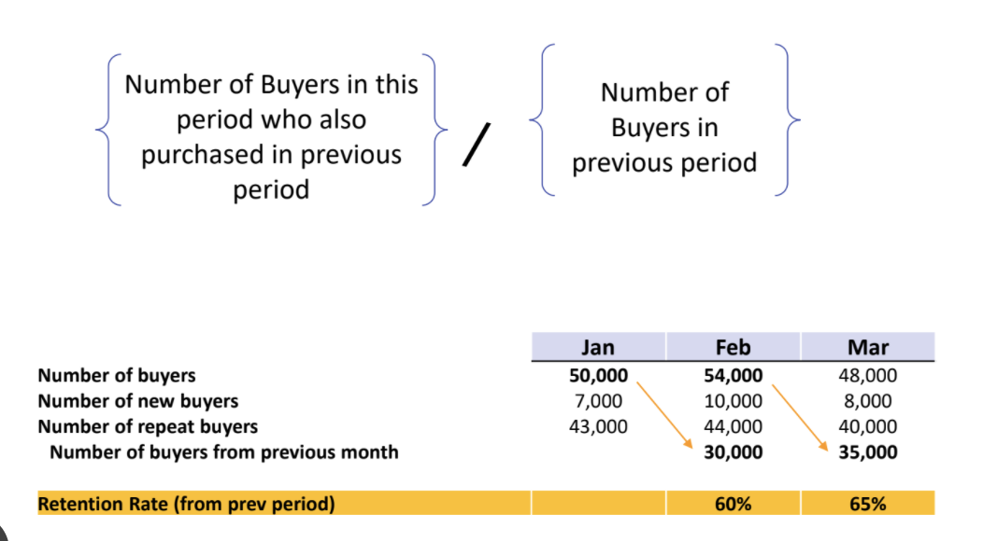
Customer
Retention
Rate (CRR)
How to find new/repeated buyers in a new period?

